Slide 1
Datacrowd
Final Presentation TEAM 01
Tsampras Konstantinos Papoutsas Georgios

Slide 2




Mission Statement
Crowd Monitoring in Public Spaces
Problems:
Overcrowding
Disease Transmission Risk [Hospitals, Public Spaces]
Air Quality Considerations [Closed areas, Shops etc.]
Personal Scheduling
Avoid High Traffic Hours or Spaces
Visit recreational spaces during peak popularity
Resource Management
Ineffective Employee timetables
Marketing in Public Spaces

Slide 3
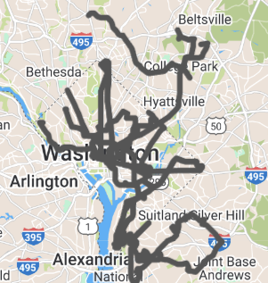
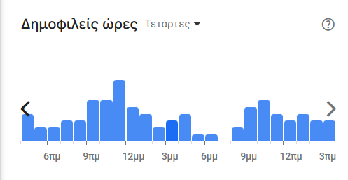
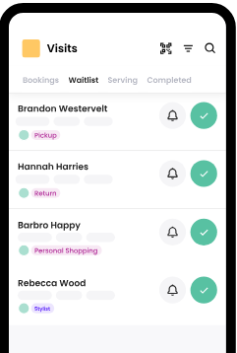
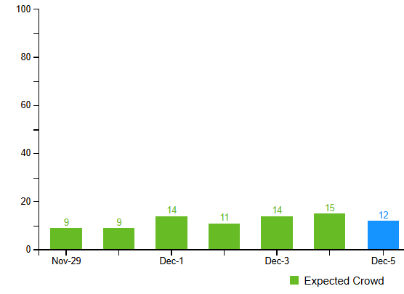
Other solutions
Features/App | Public Transit apps | Avoid crowds | Waitwhile | Google Places API | Foursquare | Datacrowd
Crowd Prediction |  | X | X | X | X | X
Multi-source model |  |  |  |  |  | X
Business & Authorities Insights |  |  | X | X | X | X
Commute Scheduling | X |  |  | X | X | X
https://www.wmata.com/service/status/
https://avoid-crowds.com/
https://waitwhile.com/
https://developers.google.com/maps/documentation/places/web-service
https://foursquare.com/

Slide 4

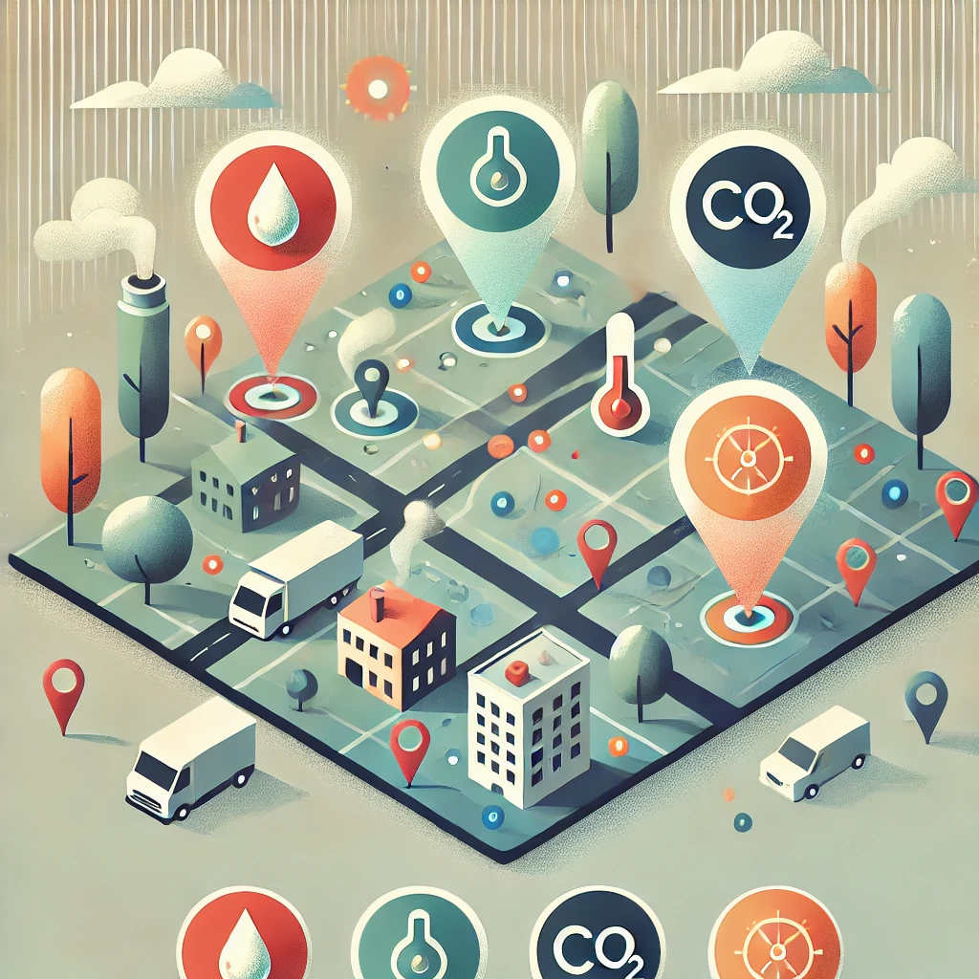

Data sources
Collect data from:
Traffic in public networks (WiFi4EU, Eduroam)
Environmental sensors (CO₂, Temperature, Humidity)
Google APIs (Air Quality, Maps, Geocoding, Directions, Places)
Web Scraping Google Maps

Slide 5
Requirements
Target audience
Access to traffic in public networks (~25€ each)
Google APIs (~12€ per month)
Sensors (CO₂, Temperature, Humidity) (~69€)
Citizens
Students
Users of Public Transport and Services
Tourists
Authorities and Businesses
Educational Institutions
Municipal Authorities
Private Businesses
Groups of Businesses
https://www.kotsovolos.gr/computing/networking/switches-access-points/215768-tp-link-access-point-tl-wa801n
https://developers.google.com/maps/documentation/places/web-service/overview
https://mapsplatform.google.com/pricing/?utm_experiment=13102152
https://mclimate.eu/products/mclimate-co2-sensor-notifier-lorawan?variant=47859023806796
Notes:
Το κοστος των google apis βγηκε εμπειρικα με βαση την χρηση του εκαστοτε API στο development

Slide 6
Citizens’ Experience
A citizen wants to navigate efficiently to a destination of their choice while avoiding overcrowded areas and being aware of the air quality along the way.
By using our service, they receive optimized route suggestions based on real-time crowd data, helping them choose less congested and more comfortable paths. Additionally, they gain access to air quality insights for the areas they pass through, ensuring a healthier and more informed travel experience

Slide 7
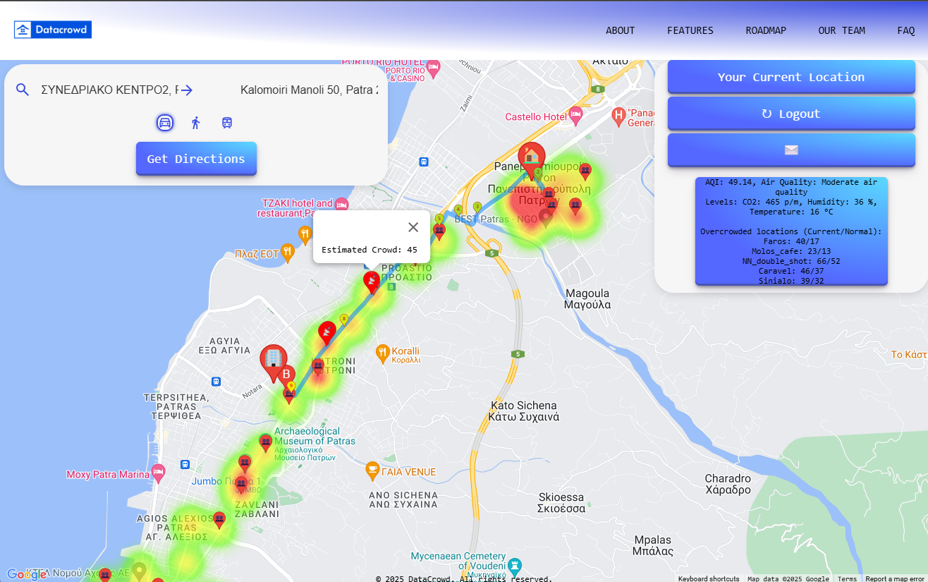
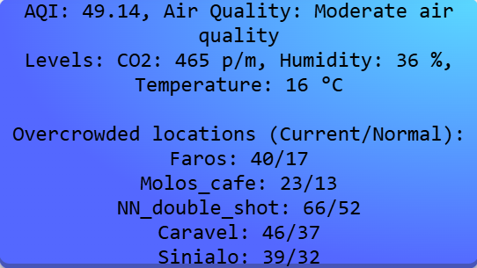


Citizens

Slide 8
Businesses’ Experience
A business owner wants to manage employee schedules more efficiently and advertise to the public during peak hours and high-traffic locations. They also want access to air quality data to optimize ventilation for better customer and employee satisfaction and experience.
By using our service, they gain access to historical, real-time and predictive crowd estimation data, based on the sensors of their choice. Additionally, they can purchase premium access to the entire sensor network, beyond those located within their own business premises.

Slide 9
Authorities’ Experience
Authorities want to monitor crowd density and air quality to improve public safety, and citizen well-being.
By using our service, they gain historical, real-time and predictive insights on crowd movement and air quality, helping them manage high-traffic areas, and enhance public space efficiency.

Slide 10
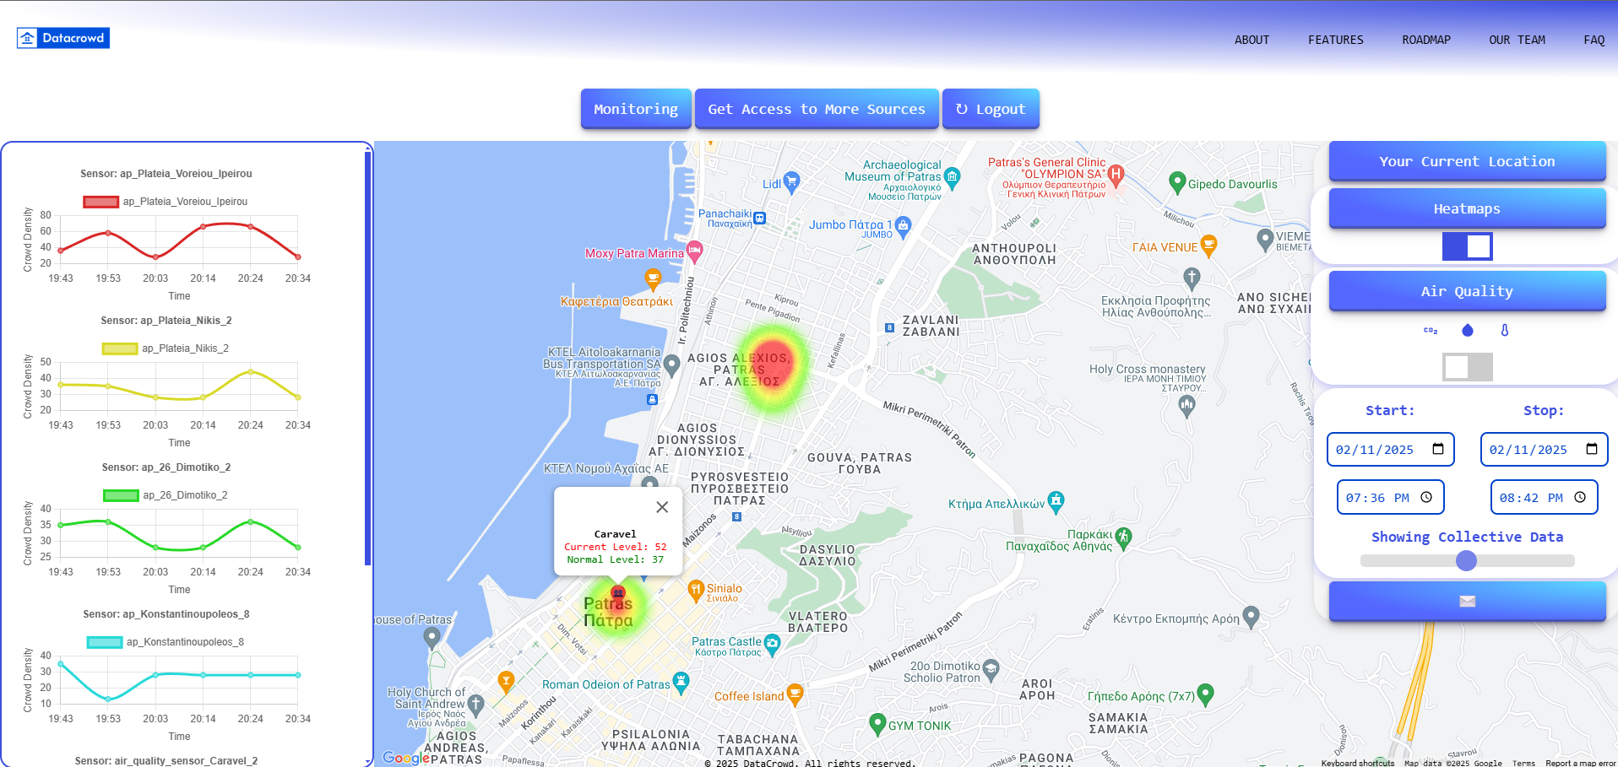
Businesses
Notes:
Access Points Readings indicating Crowd Density
and Co2 levels translated into Crowd Density

Slide 11
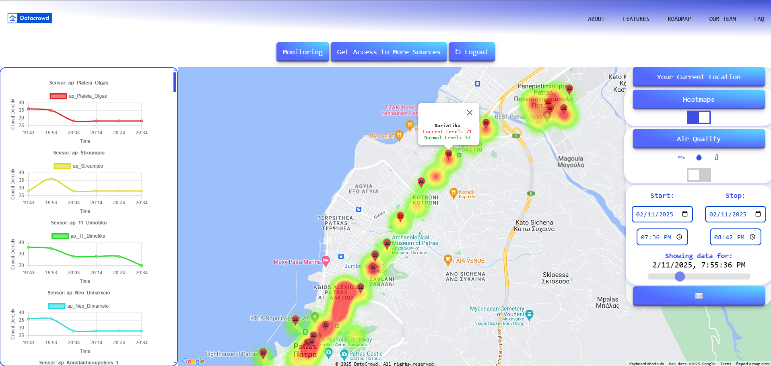
Authorities
Notes:
Access to all sensors

Slide 12
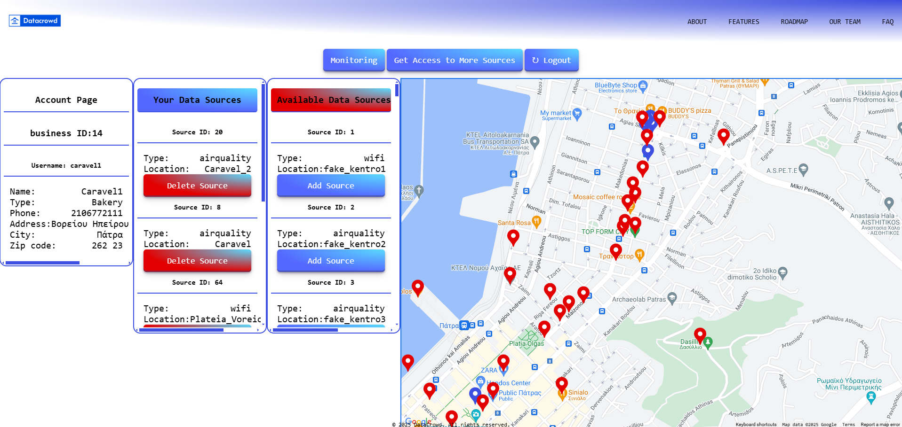
Data Sources Marketplace

Slide 13
Data processing
The sensor data needs to be organized and processed.
The access point traffic data will be used to estimate the number of people connected to the Local Area Network.
The CO2 readings from the climate sensors will be used to determine the rough size of the crowd in a closed space.
Live and historic data from Web Scraping Google Maps will be used for live and predictive crowd estimations.

Slide 14
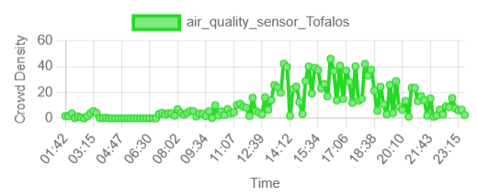
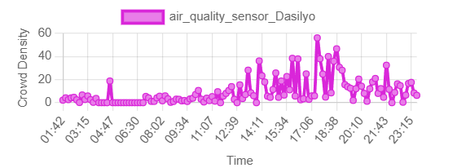
Fake Data Generation
We use a combination of real and fake data for our model.
Real Climate Sensor data from our lab.
Real Access Point data from Aps around the Campus
Fake Climate Sensors around the Campus and City center
Fake Access Point data at real PatrasWifi locations
Fake data are set to follow shifted Gaussian curves during the day with a chance of variation.
https://smartcity.patras.gr/map?typeId=4

Slide 15
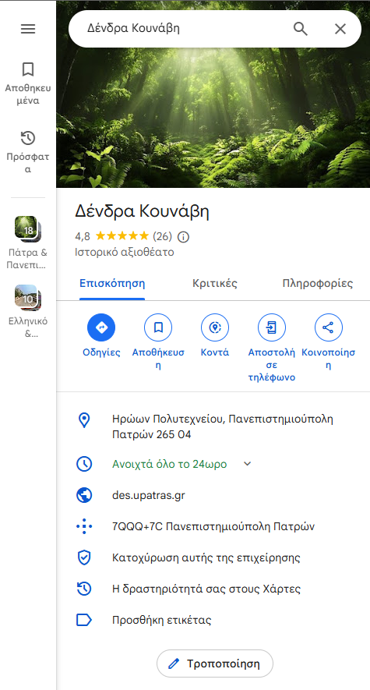
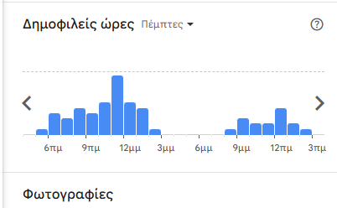
Web Scraping Popular Times From Google Maps

Slide 16
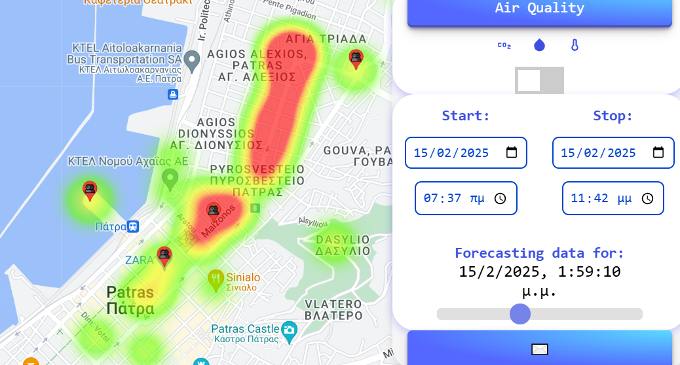
Crowd Estimations and Predictions
Crowd estimations are conducted for Access Point and Climate Sensor locations.
Using the number of connected users or the concentration of CO₂, an estimation is conducted for the number of people in the area.
Predictions for future time slots use current crowd estimations and curve data (according to the current and target date) in order to produce future heatmaps and graphs.

Slide 17
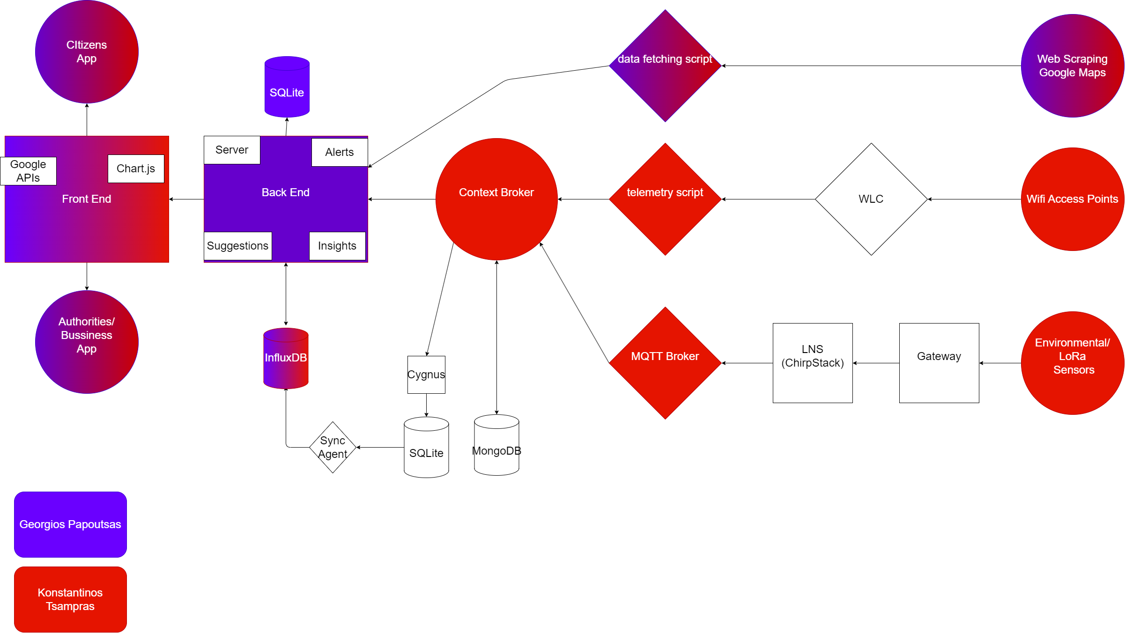
Final App Architecture

Slide 18
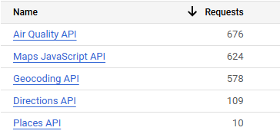
Technologies
Google APIs
Sensor Protocols: LoRa, SNMP
University Lab Infrastructure:
Context Broker
Back End:
Node.js
Front End:
Html, CSS, Handlebars
Databases:
MongoDB, Sqlite3, InfluxDB
Graphs
Chart.js
Smart Data Models:
For sensor data*
Design:
Figma
Web Scraping:
Selenium, BeatifulSoup
https://github.com/smart-data-models/dataModel.OCF/tree/master/Measurement
https://developers.google.com/maps

Slide 19
Difficulties Encountered and Technologies not in final build
Live Camera Feeds
AI model
Google Places API doesn’t provide crowd density data
Time Zone Inconsistency in Data(InfluxDB, JS Date, Local)

Slide 20

VIDEO DEMO
https://youtu.be/0GJYFtE6fGQ
https://github.com/Papiqulos/Project_IoT

Slide 21

Thank you for your time!

